Slide 1


“Jai Sri Gurudev” S J C INSTITUTE OF TECHNOLOGY DEPARTMENT OF INFORMATION SCIENCE AND ENGINEERING
The Project Phase 2 Review
On
“REAL-TIME ATTENTION SPAN TRACKING
IN ONLINE EDUCATION”
PRESENTED BY
ADARSH K R 1111111 1111 11111111111SJ19IS002
RAKSHITHA H G 1SJ19IS128
G YOGA SAI GANESH 1SJ19IS036
GOVARDHAN J A 1SJ19IS037
Under the guidance of
Prof. Ambika L G
Dept of ISE , SJCIT

Slide 2
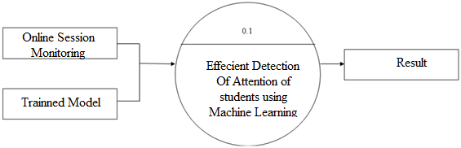
Data Flow Diagrams
REAL-TIME ATTENTION SPAN TRACKING IN ONLINE EDUCATION
Level-0:
Fig : 1
Level: 0 describes the overall process of the project. We are passing academic online sessions and its Trained Model as input system will efficiently detect attention spam in the classes using machine learning algorithm.

Slide 3
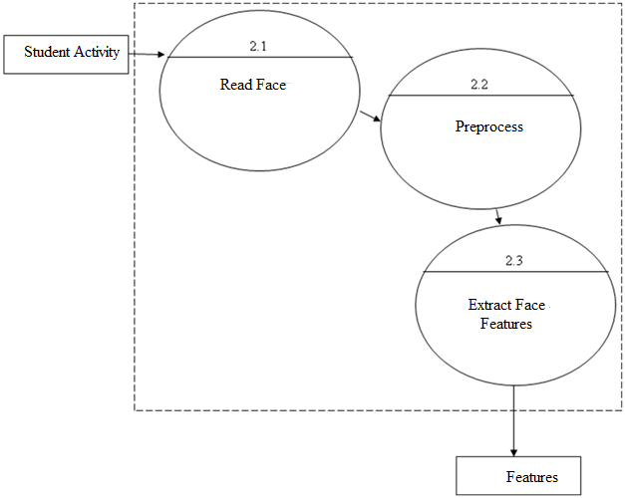
Data Flow Diagrams(Cont..)
REAL-TIME ATTENTION SPAN TRACKING IN ONLINE EDUCATION
Level-1:
Fig : 2
Level: 1 describes the first step process of the project. We are passing student activities of online meeting System will read activities and detect the face and preprocess and extract the features like, eyes, nose, mouth etc..

Slide 4
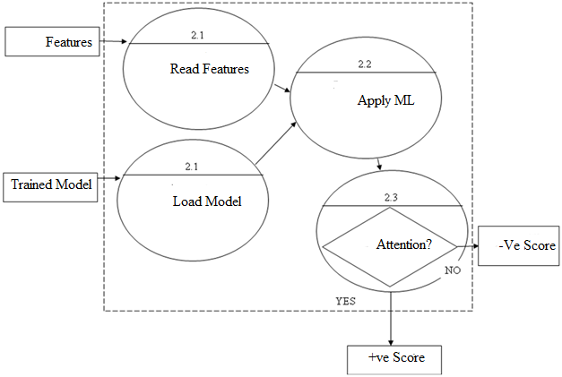
Data Flow Diagrams(Cont..)
REAL-TIME ATTENTION SPAN TRACKING IN ONLINE EDUCATION
Level-2:
Fig : 3
Level: 2 describes the final step process of the project. We are passing extracted features data from level 1 and trained model as input. System will read features and Load the model and predict attention of student and provide the score.

Slide 5
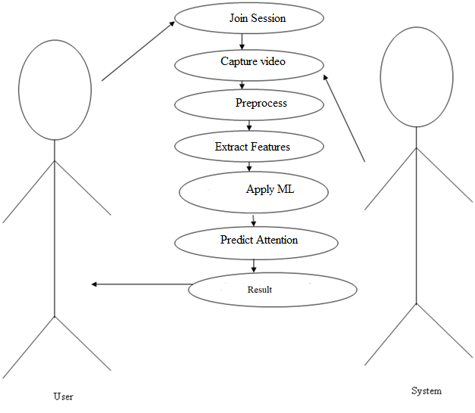
Case Diagrams
REAL-TIME ATTENTION SPAN TRACKING IN ONLINE EDUCATION
.
Fig : 4

Slide 6
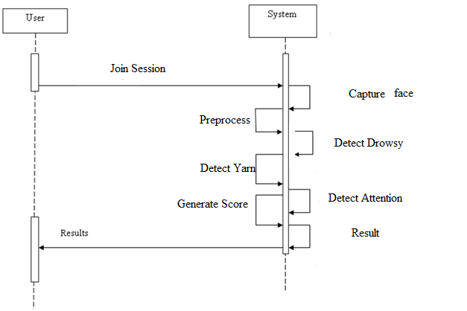
Sequence Diagrams
REAL-TIME ATTENTION SPAN TRACKING IN ONLINE EDUCATION
Fig : 5

Slide 7
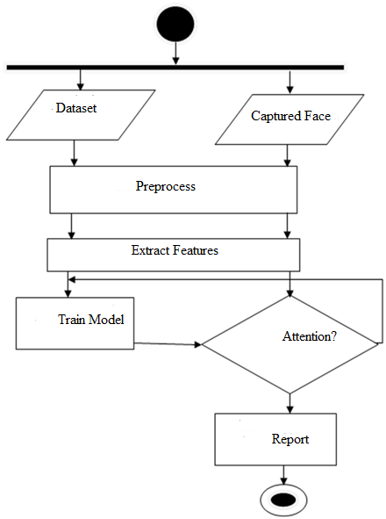
Activity Diagram
REAL-TIME ATTENTION SPAN TRACKING IN ONLINE EDUCATION
Fig : 6

Slide 8
Implementation
REAL-TIME ATTENTION SPAN TRACKING IN ONLINE EDUCATION
MODULES : We have implemented this project using following modules.
Facial Landmark Detection
Blink Rate Detection
Eye-gaze Tracking
Emotion Classification
Overall score Calculation

Slide 9
Modules Description:
REAL-TIME ATTENTION SPAN TRACKING IN ONLINE EDUCATION
1) Facial Landmark Detection
. Face detection is implemented using the Viola-Jones algorithm, which uses a windowing mechanism to scan images ….for identifying features of human faces. The project provides an efficient real-time approach to extract 68 key points .....from the detected face image using OpenCV’s dlib library .
. The landmarks are classified into five categories of facial features: eyebrows, eyes, nose, mouth, and jaw, which are . . denoted sequentially using the key points.
Pseudo code:
Facial Landmark Detection
Input: Captured face
Output: Identification of facial features
Step 1: Capture student face
Step 2: Convert into gray
Step 3: Extract the face features using haar cascade classifier.
Step 4: Detect the face landmarks in the frame.
Step 5: Return landmark

Slide 10
Modules Description:
REAL-TIME ATTENTION SPAN TRACKING IN ONLINE EDUCATION
2) Blink Rate Detection
. Blink rate is one of the important factors to determine the state of mind - whether the student is actively listening or , , drowsy during the class.
. We calculate the number of blinks continuously on an interval of 5 seconds to determine the average blink rate of the user.
. The EAR threshold value is set as 0.2 based on test experiments. We tested the blink detection module on 306 images ,,,,comprising of 156 closed eyes and 150 open eyes and classified the blinks with an accuracy of 91.02% and open eyes , ,,..with an accuracy of 92.66%.
Pseudo code:
Blink Rate Detection
Input: Eye Co-ordinates
Output: Drowsy score
Step 1: Capture student face
Step 2: Read eye coordinates
Step 3: calculate eye width and height.
Step 4: Apply Euclidean distance formula to detect the eye blinking ratio .
Step 5: Return Drowsy score

Slide 11
Modules Description:
REAL-TIME ATTENTION SPAN TRACKING IN ONLINE EDUCATION
3) Eye-gaze Tracking
. The eye-gaze of a student is tracked to determine where he is looking at and is often closely associated with the , ,. M.distraction level of the student. we analyze the extracted eye region coordinates for rectangular features to identify ….eye regions containing the pupil.
. We collected 150 images with two different classes: looking straight and looking away. Our model was able to ....classify the eye gaze correctly for 113 images with an accuracy of 75.33%.
Pseudo code:
Eye Gaze Tracking
Input: Eye Co-ordinates
Output: eye moment score
Step 1: Capture student face
Step 2: Read eye coordinates
Step 3: Detect eye pupil.
Step 4: Measure eye pupil movements.
Step 5: Return eye pupil movement score.

Slide 12
Modules Description:
REAL-TIME ATTENTION SPAN TRACKING IN ONLINE EDUCATION
4) Emotion Classification
The emotion of the person attending the online class plays a major role in his attention level. This study uses facial features such as eyes, nose, and mouth, extracted using Haarcascade classifier and facial landmark detector.
Mini Exception algorithm is used to classify the emotion of the students into seven different classes - angry, disgust, fear, happy, sad, surprise, and neutral.
The model was validated using the JAFFE dataset which contains 213 images and 7 emotions posed by 10 different Japanese women. The training set consisted of 42 and 7 classes of emotion. The test set consisted of 70 images. We obtained an average accuracy of 82.55% on our test set.
Pseudo code:
Emotion detection
Input: face image
Output: Emotion score
Step 1: Capture student face
Step 2: Convert to gray
Step 3: Extract the face features.
Step 4: Apply Miniexception model
Step 5: Detect the emotion
Step 6: Return emotion score.

Slide 13
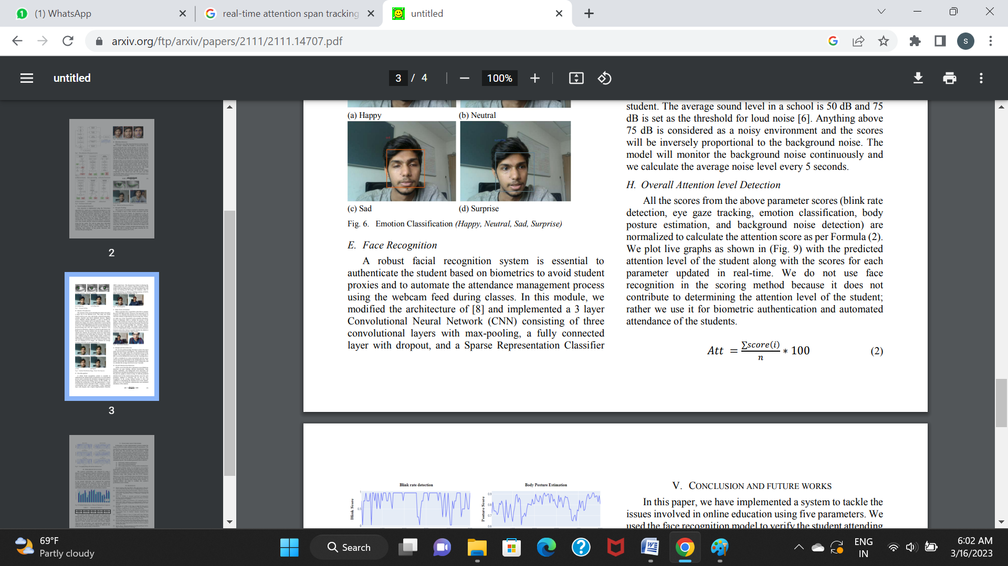
Modules Description:
REAL-TIME ATTENTION SPAN TRACKING IN ONLINE EDUCATION
5) Overall Attention level Detection
All the scores from the above parameter scores (blink rate detection, eye gaze tracking, emotion classification, body posture estimation, and background noise detection) are normalized to calculate the attention score as per Formula (2).
With the predicted attention level of the student along with the scores for each parameter updated in real-time.
Pseudo code:
Overall Attention score
Input: All the scores from previous modules
Output: Attention score
Step 1: Read all score
Step 2: Calculate average of it
Step 3: Return attention score.

Slide 14
BIBLIOGRAPHY
REAL-TIME ATTENTION SPAN TRACKING IN ONLINE EDUCATION
Work Progress
We have completed the first two modules like detecting facial landmarks and yarning detection.
Now we have stated working of next two modules.
2022-23
Dept of ISE, SJCIT
13

